Slide 1

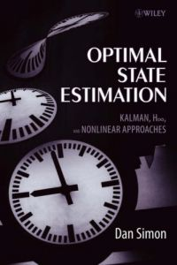
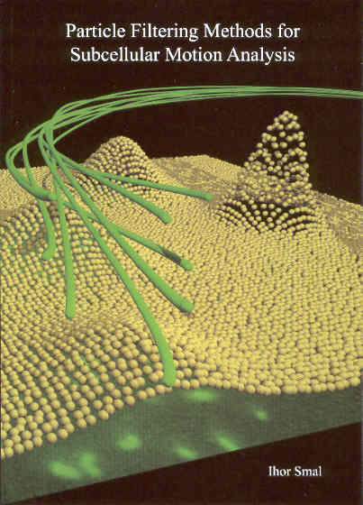
STOCHASTIC APPROACH To
State Estimation
Current Status and Open Problems
FIPSE ΦΨ-1
Olympian Village
Western Peloponnese, GREECE
29-31, August 2012
Jay H. Lee with help from Jang Hong and Suhang Choi
Korea Advanced Institute of Science and Technology
Daejeon, Korea

Slide 2
Some Questions Posed for This Session
Is state estimation a mature technology?
Deterministic vs. stochastic approaches – fundamentally different?
Modeling for state estimation – what are the requirements and difficulties?
Choice of state estimation algorithm – Tradeoff between performance gain vs. complexity increase: Clear?
Emerging applications – posing some new challenges in state estimation?

Slide 3
Part I
Introduction

Slide 4
The Need of State Estimation
State Estimation is an integral component of
  Process Monitoring: Not all variables of importance can be measured with enough accuracy.
  RTO and Control: Models contain unknowns (unmeasured disturbances, uncertain parameters, other errors)
State estimation enables the combining of system information (model) and on-line measurement information for
  Estimation of unmeasured variables / parameters
  Filtering of noises
  Prediction of system-wide future behavior

Slide 5
Deterministic vs. Stochastic Approaches
Deterministic Approaches
  Observer approach, e.g., pole placement, asymptotic obs.
  Optimization-based approach, e.g., MHE
  Focus on state reconstruction w/ unknown initial state
  Emphasis on the asymptotic behavior, e.g., observer stability
  There can be many “tuning” parameters (e.g., pole locations, weight parameters) difficult to choose.
Stochastic Approaches
  Require probabilistic description of the unknowns (e.g., initial state, state / measurement noises)
  Observer approach: Computation of the parameterizd gain matrix minimizing the error variance, or
  Bayesian Approach: Recursive calculation of the conditional probability distribution

Slide 6
Deterministic vs. Stochastic Approaches
Stochastic approaches require (or allow for the use of) more system information but can be more efficient and also return more information (e.g., uncertainty in the estimates, etc.)
  Important for “information-poor” cases
Both approaches can demand selection of “many” parameters difficult to choose, e.g., the selection of weight parameters amounts to the selection of covariance parameters.
Stochastic analysis reveals fundamental limitations of certain deterministic approaches, e.g., Least squares minimization leading to a linear type estimator is optimal for the Gaussian case only.
In these senses, stochastic approaches are perhaps more general but deterministic observers may provide simpler solution for certain problems (“info-rich” nonlinear problems).

Slide 7
Is State Estimation A Technology?
For state estimation to be a mature technology, the followings must be routine:
  Construction of a model for state estimation – including the noise model
  Choice of estimation algorithms
  Analysis of the performance limit
Currently,
  The above are routine for linear, stationary, Gaussian type process.
  Far from being routine for nonlinear, non-stationary, non-Gaussian cases (most industrial cases)!

Slide 8
Part II
Modeling for State Estimation

Slide 9
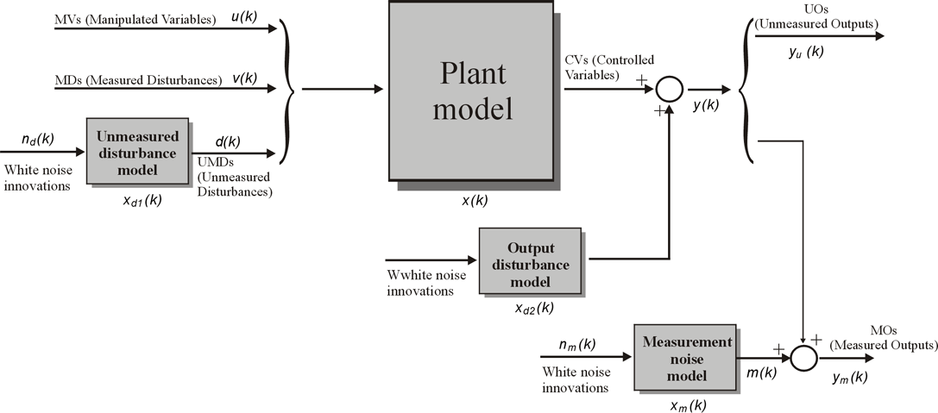
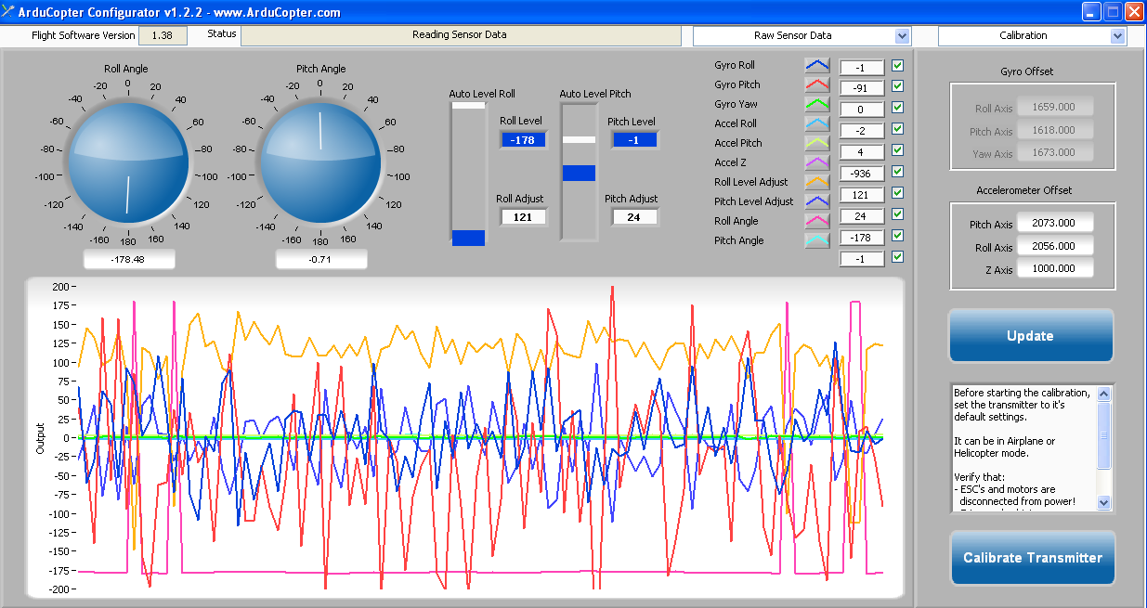
Modeling Effort vs. Available Measurement
Complementary!
Model
Sensed Information
Quantity (Number)
Quality (Accuracy, Noise)
Model of the Unknowns (Disturbance / Noise)
Model Accuracy
“Information-rich” case: No need for a detailed (structured) disturbance model. In fact, an
effort to introduce such a model can result in a robustness problem.
“Information-poor” case: Demands a detailed (structured) disturbance model for good
performance.

Slide 10
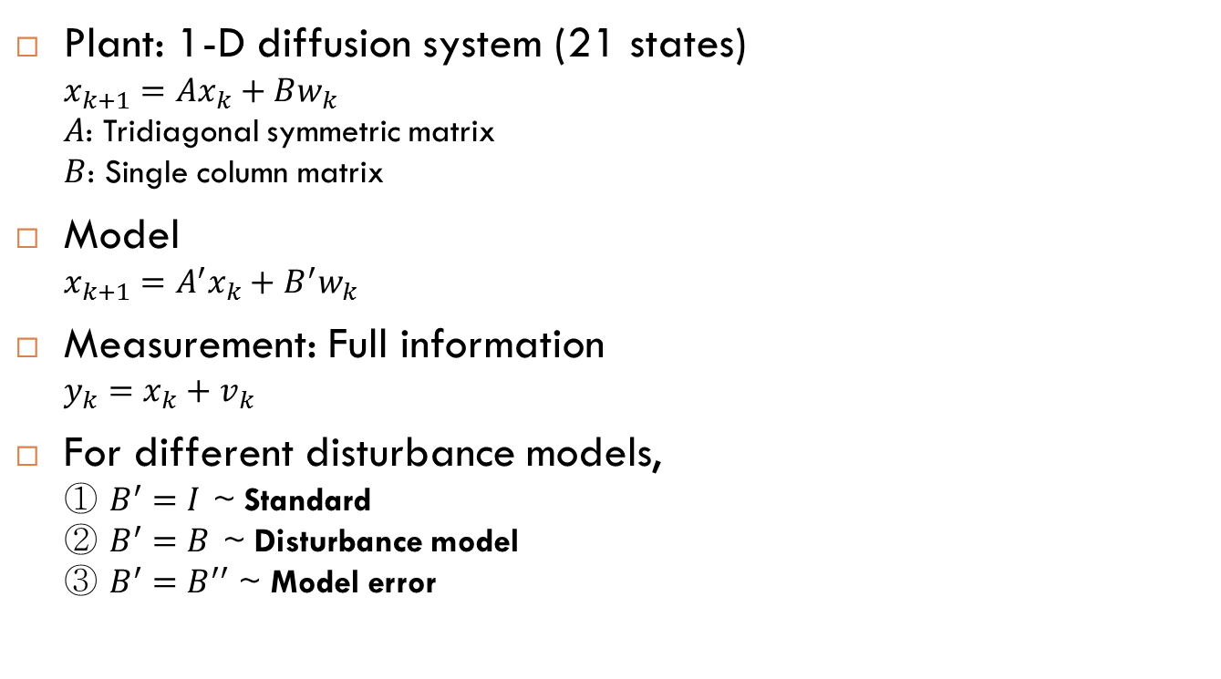
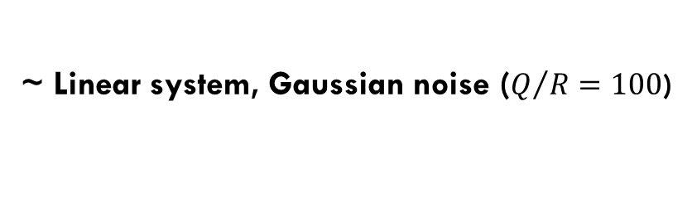
Illustrative Example

Slide 11
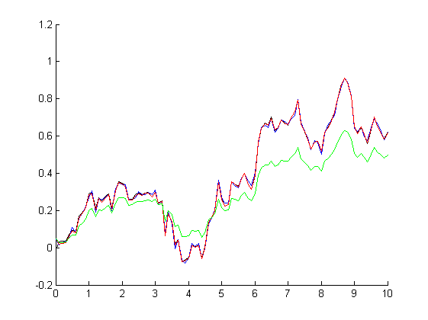
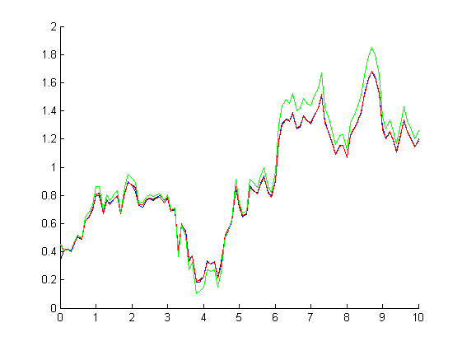
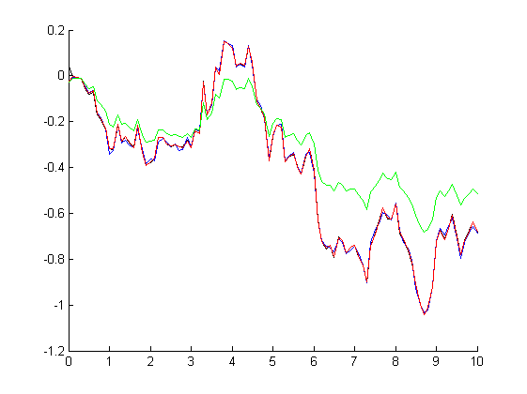






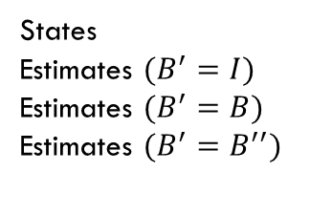
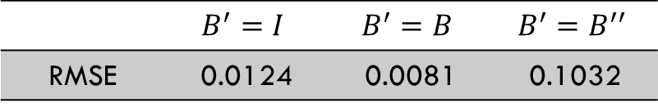
Simulation results
Full information cases
For the “info-rich” case, model error from detailed dist. modeling can be damaging.
For 1th element of x
For 10th element of x
For 21th element of x
RMSE | 0.0124 | 0.0081 | 0.1032
RMSE: Root Mean Square Error

Slide 12
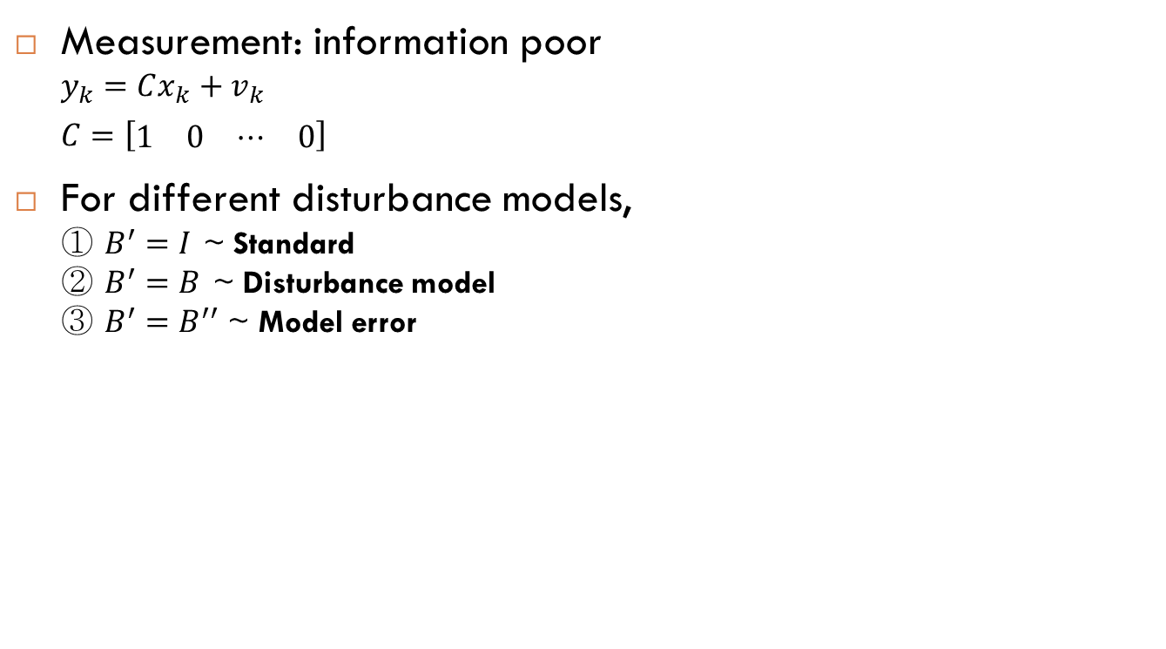
Illustrative Example

Slide 13
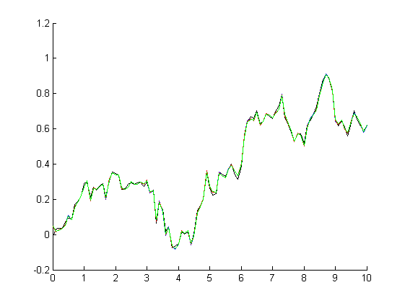
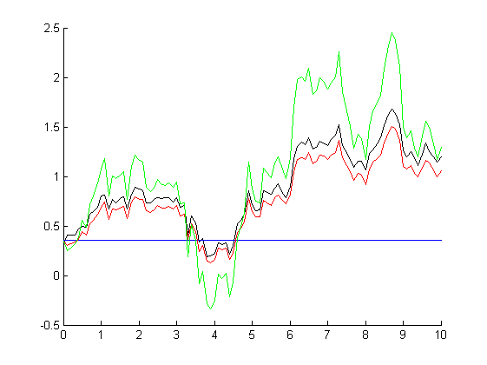
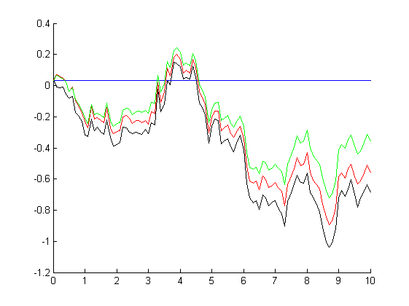
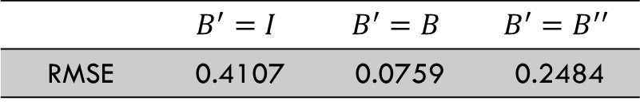
Simulation results
Information-poor case
For the “info-poor” case, detailed disturbance modeling is critical!
For 1th element of x
For 10th element of x
For 21th element of x
RMSE | 0.4107 | 0.0759 | 0.2484
RMSE: Root Mean Square Error

Slide 14
Characteristics of Industrial Process Control Problems
Relatively large number of state variables compared to number of measured variables
Noisy, inaccurate measurements
Relatively fewer number of (major) disturbance variables compared to number of state variables
Many disturbance variables have integrating or other persistent characteristics ⇒ extra stochastic states needed in the model
Typically, “info-poor”, structured unknown case
Demands detailed modeling of disturbance variables!

Slide 15
Construction of a Linear Stochastic System Model for State Estimation
Linear System Model for Kalman Filtering:
Knowledge-Driven
Data-Driven, e.g.,
Subspace ID
Deterministic Part:
These procedures often result in increased state dimension and R₁ and R₂ that are very ill-conditioned!
Innovation Form:
Disturbance:
{A, B, C, K, Cov(e)}
within some similarity transformation
Measurement Noise:

Slide 16
A Major Concern: Non-Stationary Nature of Most Industrial Processes
Time-varying characteristics
  S/N ratio: R₁/R₂ change with time.
  Correlation structure: R₁ and R₂ change with time
  Disturbance characteristics: The overall state dimension and system matrices can change with time too.
“Efficient” state estimators that use highly structured noise models (e.g., ill-conditioned covariance matrices) are often not robust!
  Main reason for industries not adopting the KF or other state estimation techniques for MPC.

Slide 17
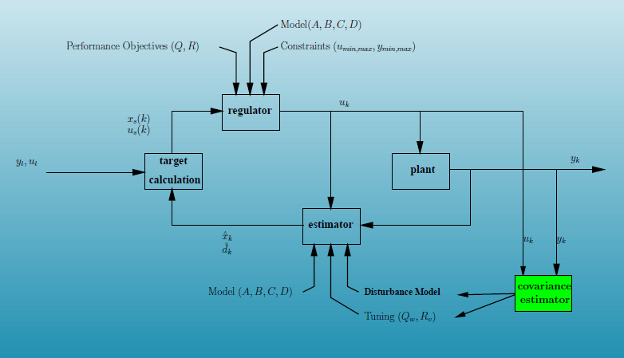
Potential Solution 1: On-Line Estimation of R₁ and R₂ (or the Filter Gain)
Autocovariance Least Squares (ALS), Rawlings and coworkers, 2006.

Slide 18
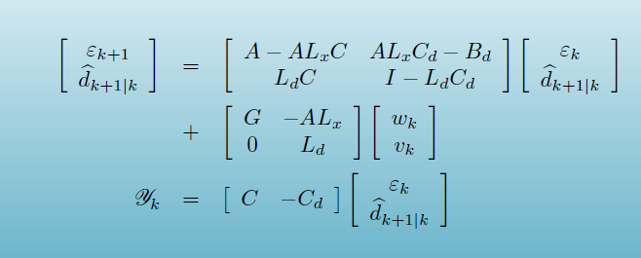
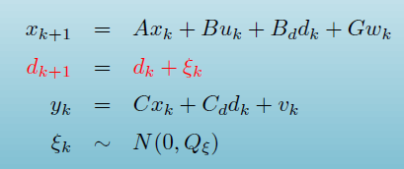
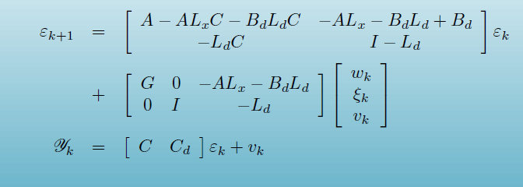
ALS Formulation
Case I: Fixed disturbance covariance
Model with IWN disturbance
Case II: Updated disturbance covariance

Slide 19

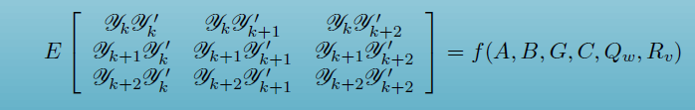

ALS Formulation
Linear least squares estimation (Case I) or nonlinear least squares Estimation (Case II)
Positive semi-definiteness constraint ⇒Semi-definite programming
Takes a large number of data points for the estimates to converge
  Not well-suited for quickly / frequently changing disturbance patterns.
Innovation data
Estimate of Auto-covariance matrix from the data

Slide 20
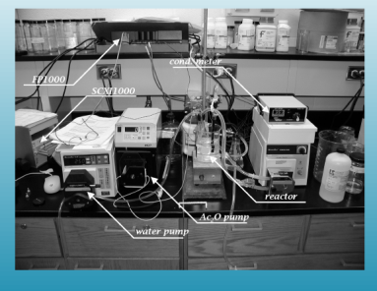
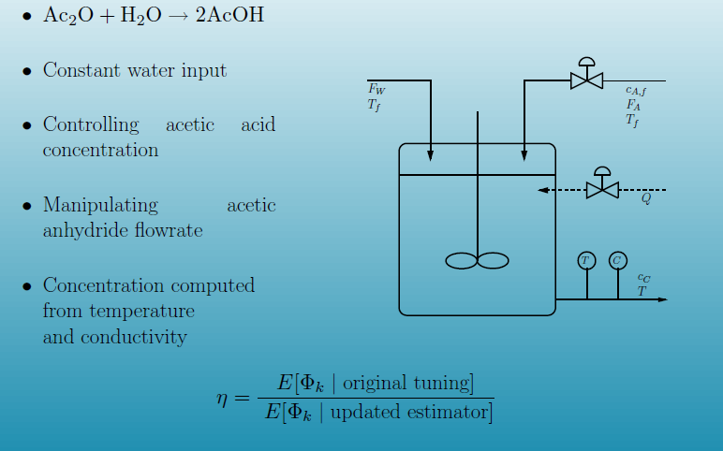
Illustrative Example of ALS
From Odelson et al., IEEE Control System Technology, 2006

Slide 21
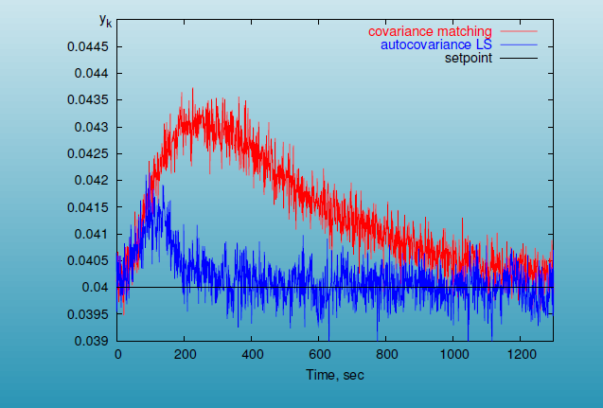
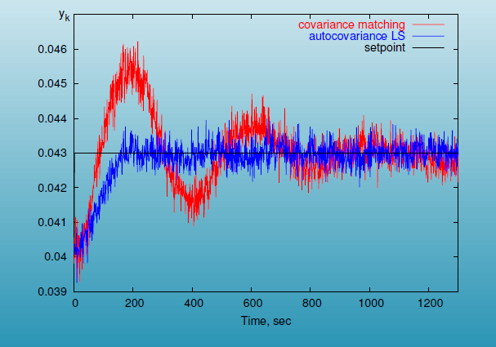
ALS vs. without ALS
Servo Control with Model Mismatch
Input Disturbance Rejection

Slide 22




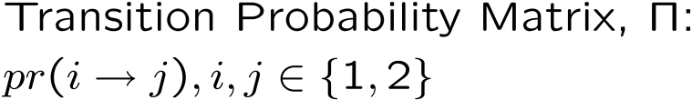
Potential Solution #2: Multi-Scenario Model w/ the HMM or MJLS Framework
Wong and Lee, Journal of Process Control 2010
1
2
(A₁, B₁, C₁, Q₁, R₁)
(A₂, B₂, C₂, Q₂, R₂)

Slide 23
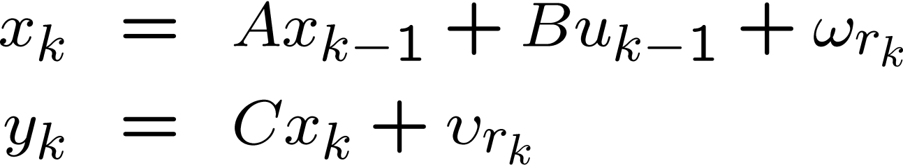
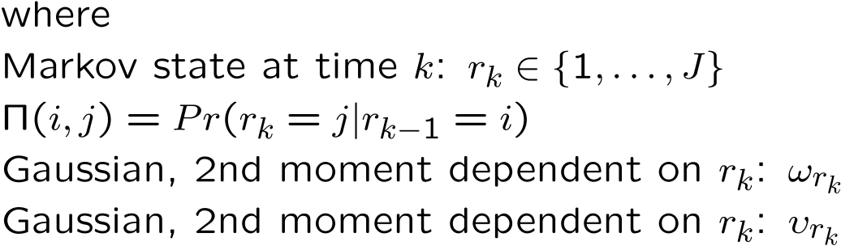
Markov Jump Linear System
Restricted Case

Slide 24
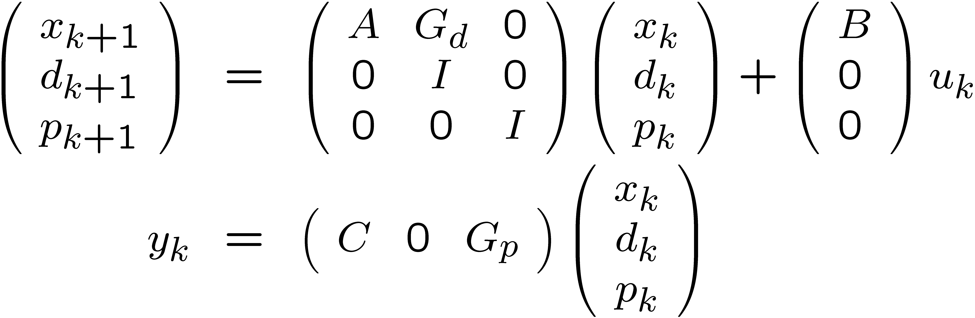
Illustrative Example: input/ output disturbance models
HMM Disturbance Model for Offset-free LMPC
i/ p disturbance
o/ p disturbance

Slide 25
Disadvantages
HMM Disturbance Model for Offset-free LMPC
Either input or output disturbance
Plant-model mismatch
{G_{d} = 0, G_{p} = I_{ny}}
  sluggish behavior
  might add state noise to compensate
IWN disturbance models are too simplistic
  do not always capture dynamic patterns seen in practice

Slide 26
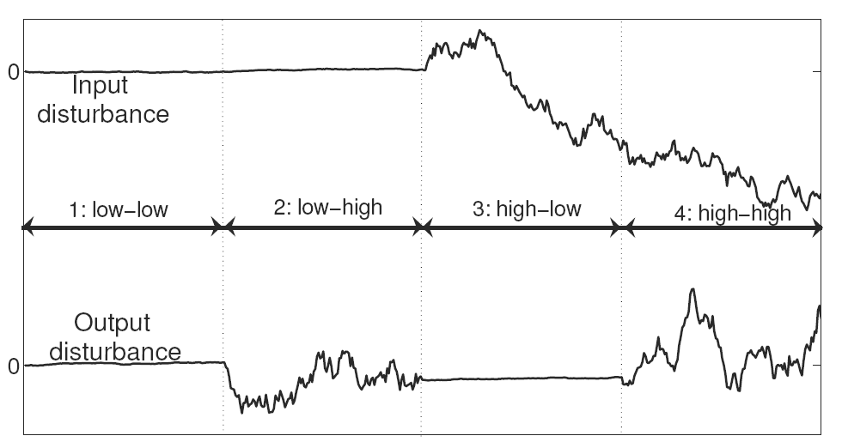
Potential disturbance scenario probabilistic transitions b/w regimes
HMM Disturbance Model for Offset-free LMPC
A hypothesized disturbance pattern common in process industries

Slide 27







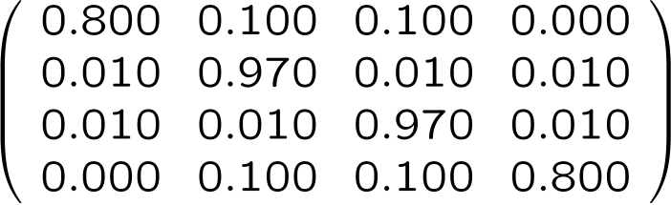

Probabilistic transitions
Markov chain modeling
HMM Disturbance Model for Offset-free LMPC
LO-LO
(r = 1)
LO-HI
(r = 2)
HI-LO
(r = 3)
HI-HI
(r = 4)
A 4-state Markov Chain

Slide 28
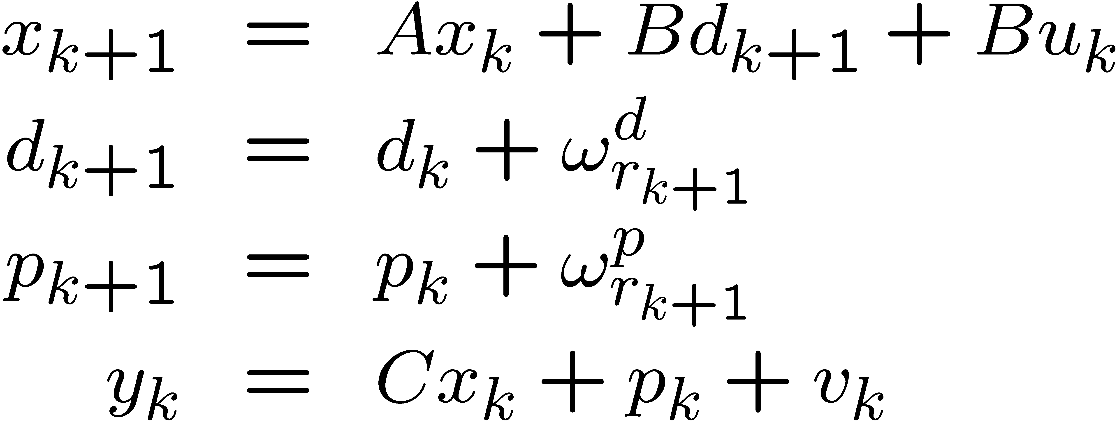
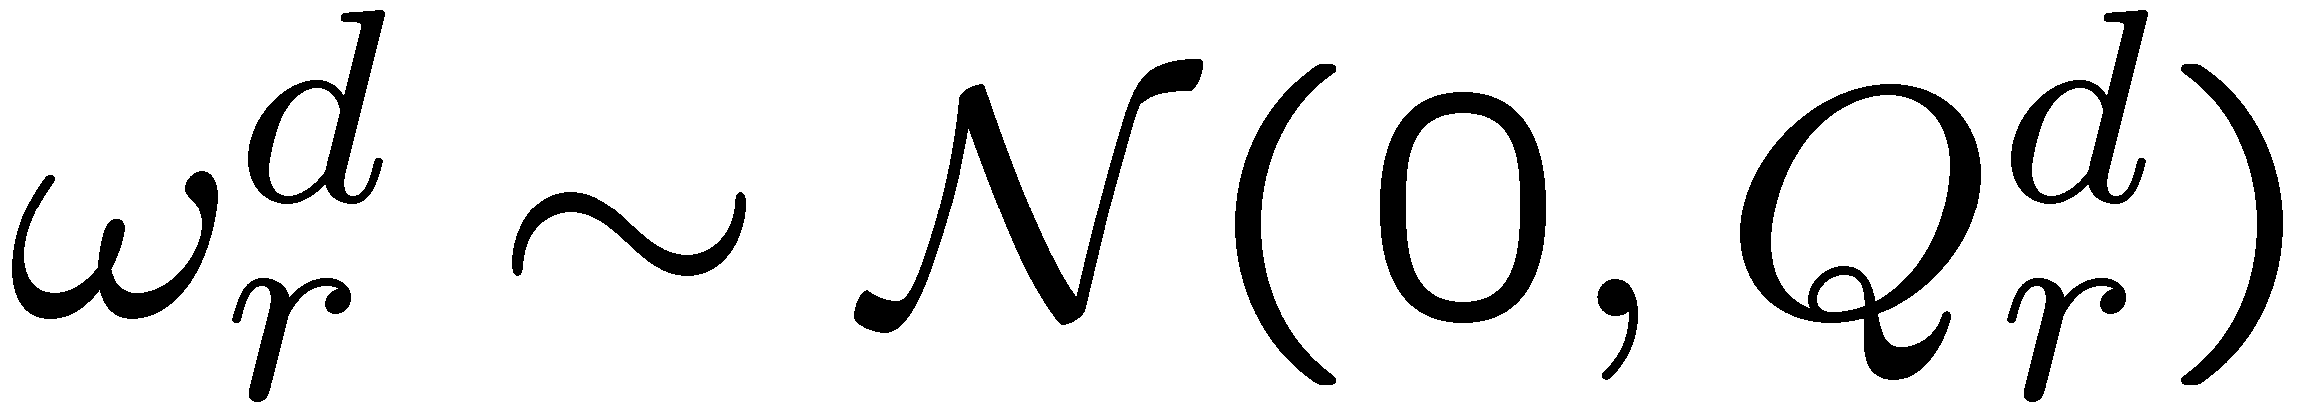
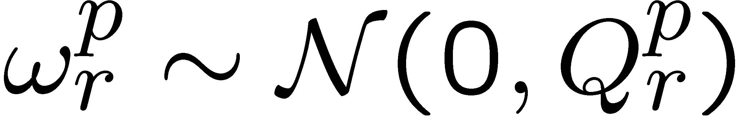
Plant model –(1)
Markov Jump Linear System
HMM Disturbance Model for Offset-free LMPC

Slide 29
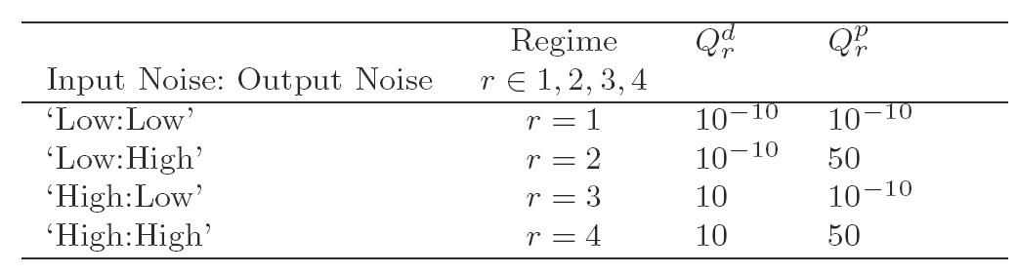
Plant model –(2)
Markov Jump Linear System
HMM Disturbance Model for Offset-free LMPC

Slide 30
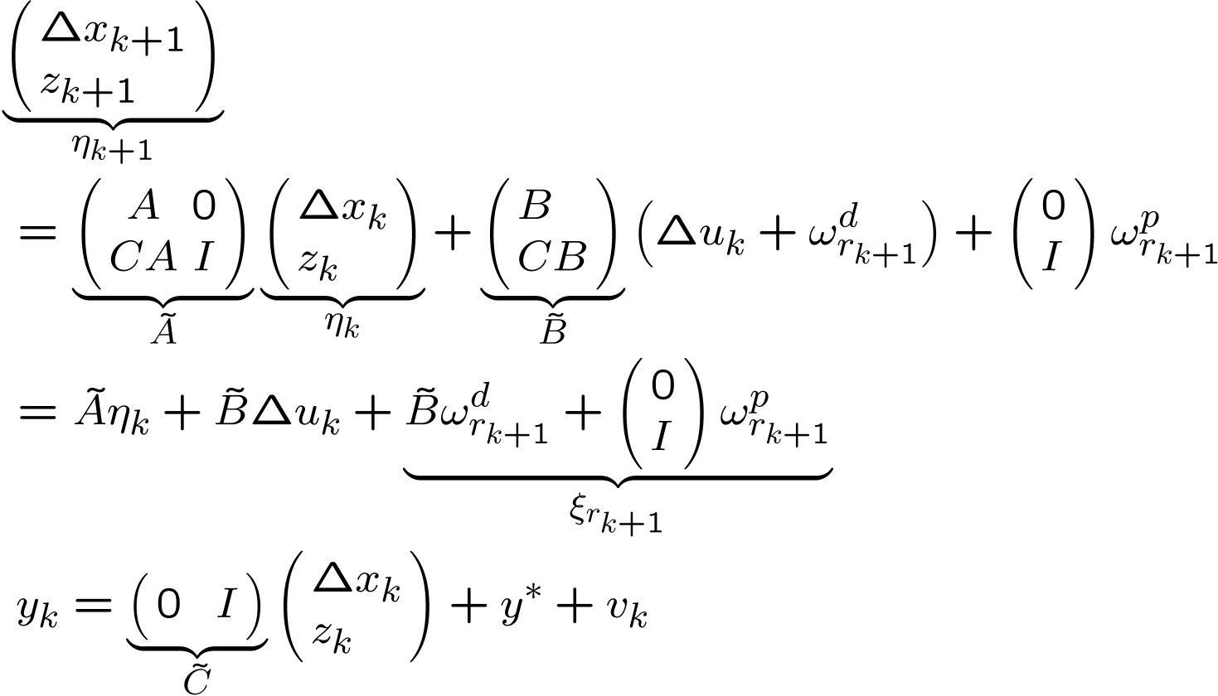
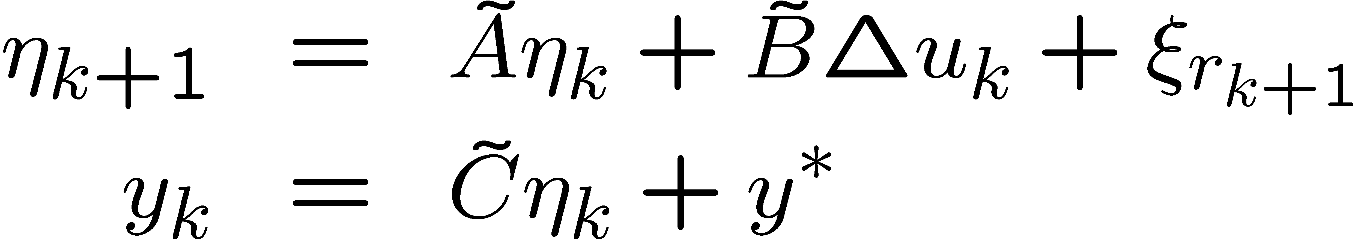
Detectable formulation* after differencing
HMM Disturbance Model for Offset-free LMPC
* used by estimator/ controller

Slide 31
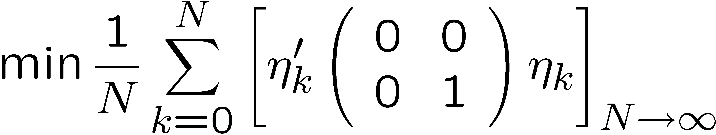
Example
HMM Disturbance Model for Offset-free LMPC
(A = 0.9, B = 1, C = 1.5)
Unconstrained optimization

Slide 32
Simulations
4 scenarios*
HMM Disturbance Model for Offset-free LMPC
1: Input noise << output noise (LO-HI)
2: Input noise >> output noise (HI-LO)
3: Input noise ~ output noise (HI-HI)
4: Switching disturbances
*: use parameters given in previous table

Slide 33
Four estimator/ controller designs
HMM Disturbance Model for Offset-free LMPC
1. Output disturbance only
  Kalman filter
2. Input disturbance only
  Kalman filter
3. Output and input disturbance
  Kalman filter
4. Switching behavior
  need sub-optimal state estimator

Slide 34
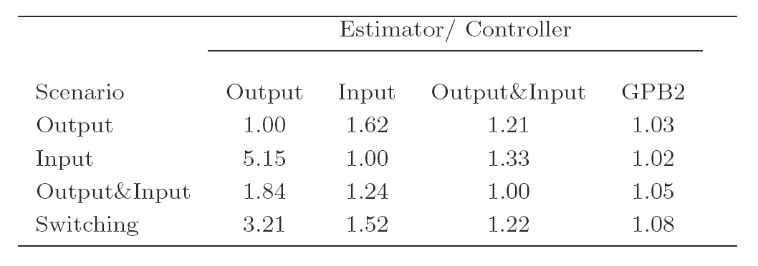
Mean of relative squared error
(500 realizations*)
HMM Disturbance Model for Offset-free LMPC
*: normalized over benchmarking controller (known Markov state)

Slide 35
Scenario 4 switching disturbance – y vs. time

Slide 36
Construction of A Nonlinear Stochastic System Model for State Estimation
Linear System Model for Kalman Filtering:
Knowledge-Driven
Data-Based Construction of A Nonlinear Stochastic System Model Is An Important Open Problem!
Data-Driven
Deterministic Part:
Innovation Form:
Disturbance:
{f,g}
Nonlinear Subspace Identification?
Measurement Noise:

Slide 37
Part III
State Estimation Algorithm

Slide 38
State of The Art
Linear system (w/ symmetric (Gaussian) noise)
  Kalman Filter – well understood!
Mildly nonlinear system (w/ reasonably well-known initial condition and small disturbances)
  Extended Kalman Filter (requiring Jacobian calculation)
  Unscented Kalman Filter (“derivative-free” calculation)
  Ensemble Kalman Filter (MC sample based calculation)
(Mildly) Linear system (w/ asymmetric (non-Gaussian) noise)?
  KF is only the best linear estimator. Optimal estimator?
Strongly nonlinear system?
  Resulting in highly non-gaussian (e.g., multi-modal) distributions
  Recursive calculations of the first two moments do not work!

Slide 39
EKF - Assessment
The extended Kalman filter is probably the most widely used estimation algorithm for nonlinear systems.
However, more than 35 years of experience in the estimation community has shown that it is difficult to implement, difficult to tune, and only reliable for systems that are almost linear on the time scale of the updates.
Many of these difficulties arise from its use of linearization
Julier and Uhlmann (2004)

Slide 40
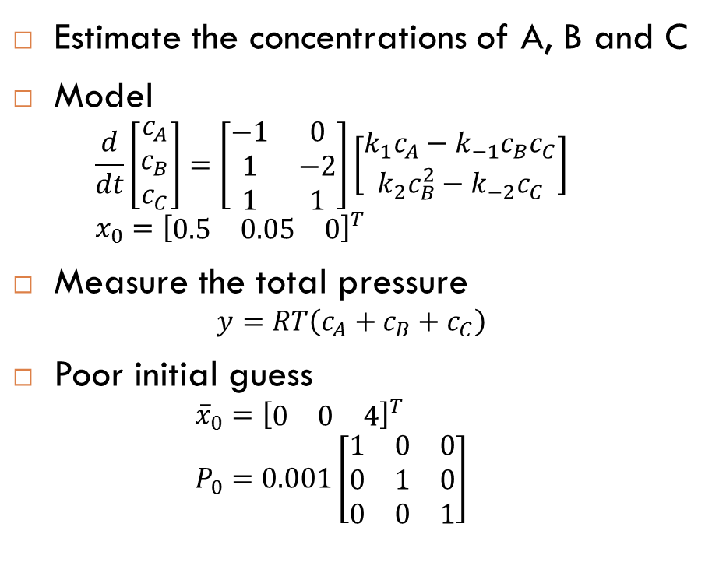

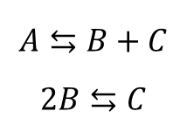



Illustrative Example
P
Rawlings and Lima (2008)

Slide 41
Steady-State Error Results – Despite Perfect Model Assumed.
C
C
Concentration
B
Pressure
A
A
B
Time
Time
Component | Predicted EKF Steady-State | Actual Steady-State
A | -0.027 | 0.012
B | -0.246 | 0.183
C | 1.127 | 0.666
Real
Estimates

Slide 42
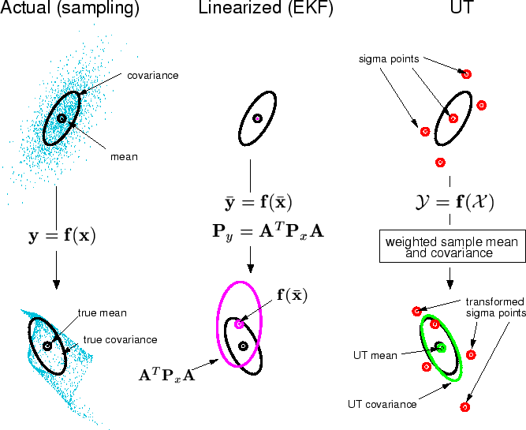
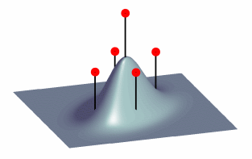



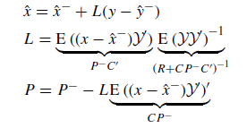



EKF vs. UKF
(⇒UKF)
Similar calculations are performed for the measurement update step.
2L+1

Slide 43
EKF vs. UKF
 | EKF | UKF
What’s tracked | First two moments | First two moments
Procedure | Linearization | Approximation w/ 2L+1 sigma points
Computation | Single integration at each step Requires calculation of the Jacobian matrices | Up to 2L+1 integrations at each step “Derivative-free”
The Verdict | Extensively tested Works well for mildly linear systems with good initial guess Can show divergence otherwise | Developed and tested mostly for aerospace navigation and tracking problems Often shows improved performance over the EKF

Slide 44
EKF vs. UKF: Illustrative Examples
Romanenko and Castro, 2004
  4 state non-isothermal CSTR
  State nonlinearity
  The UKF performed significantly better than the EKF when the measurement noises were significant (requiring better prior estimates)
Romanenko, Santos, and Afonso, 2004
  3 state pH system
  Linear state equation, highly nonlinear output equation.
  The UKF performed only slightly better than the EKF
In what cases does the UKF fail? Computational complexity between EKF vs. UKF?

Slide 45

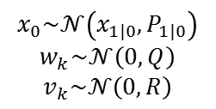
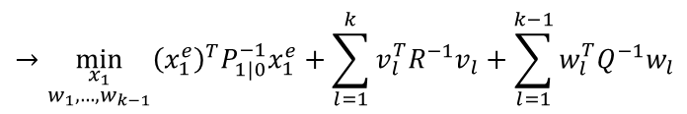

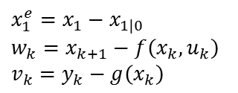
BATCH (Non-Recursive) Estimation:
Joint-MAP Estimate
Probabilistic Interpretation of the Full-Information Least Squares Estimate (Joint MAP Estimate)
Nonlinear, nonconvex program in general.
Constraints can be added.
System
(By taking negative logarithm)

Slide 46
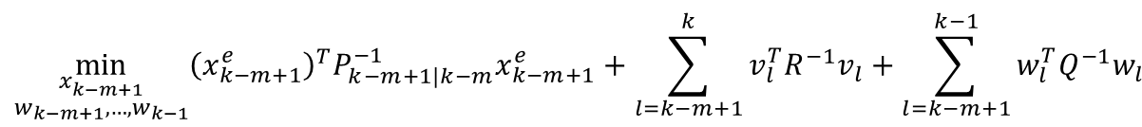

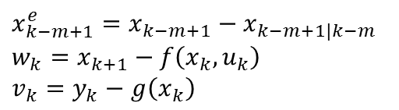
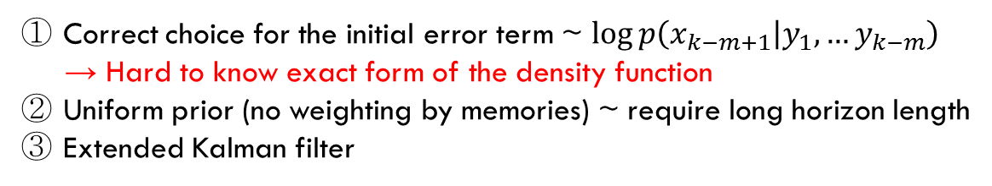
Recursive: Moving Horizon Estimation
Initial Error Term – Its Probabilistic Interpretation
Negative effect of linearization or other approximation declines with the horizon size

Slide 47




MHE for Nonlinear Systems: Illustrative Examples
C
C
Concentration
Pressure
B
B
A
A
Time
Time
Component | Predicted MHE Steady-State | Actual Steady-State
A | 0.012 | 0.012
B | 0.183 | 0.183
C | 0.666 | 0.666
Real
Estimates

Slide 48





MHE for Strongly Nonlinear Systems: Illustrative Examples
EKF
MHE
RMSE = 21.2674
RMSE = 13.3920
States
Estimates

Slide 49


MHE for Strongly Nonlinear Systems: Shortcomings and Challenges
RMSE is improved, but still high ~ Multi-modal density
Nonlinear MHE requires ~ 1) Non-convex optimization method
2) Arrival cost approximation
Mode 1
Mode 2
$$p$$
$$x$$
MHE approximate the arrival cost based on (uni-modal) normal distribution
→ Hard to handle the multi-modal density that can arise in a nonlinear system within MHE

Slide 50
MHE for Strongly Nonlinear Systems: Shortcomings and Challenges
The exact calculation of the initial state density function is generally not possible.
  Approximation is required for the initial error penalty.
  Estimation quality depends on the choice of approximation and the horizon length.
  How to choose the approximation and the horizon length appropriately.
Solving the NLP on-line is computationally demanding
  How to guarantee a (suboptimal) solution within a given time limit, while guaranteeing certain properties?
How to estimate uncertainty in the estimate?

Slide 51




MLE with Non-Gaussian Noises as Constrained QP
Robertson and Lee, Automatica, 2002 “On the Use of Constraints in Least Squares Estimation”
Asymmetric distribution
Maximum Likelihood Estimation

Slide 52


MLE with Non-Gaussian Noises as Constrained QP
Other common types of nonGaussian density for which MLE is expressed as QP.
Joint MAP estimation of the state for a linear system with such non-Gaussian noise terms can be formulated as a QP. ⇒ Optimal handling of some non-Gaussian noises is possible within MHE?

Slide 53























Particle Filtering for Strongly Nonlinear Systems
Sampled
densities
Sampled
densities

Slide 54





PF: Degeneracy Problem
Degeneracy phenomenon after a few iterations
Increasing variance of weights

Slide 55




PF: Optimal Importance Density
System
~ Nonlinear dynamics
~ Linear measurements
Covaricance
Mean
Importance
density

Slide 56




Particle Filtering for Strongly Nonlinear Systems: Illustrative Examples
~ Nonlinear
~ Linear
PF
PF with optimal importance function
RMSE (mean) = 7.1452
RMSE (mode) = 9.5829
RMSE (mean) = 4.7477
RMSE (mode) = 5.9934
States
Estimates (mean)
Estimates (mode)

Slide 57























PF: Resampling
Optimal importance function calculation is not possible in general.
Resampling → Removing small weights and equalizing weights
② Assign sample ~ Uniform distribution

Slide 58



Particle Filtering for Strongly Nonlinear Systems: Illustrative Examples
M. S. Arulampalam et al., IEEE Transactions on Signal Processing, 50, 2 (2002)
(Number of particles: 1000)
PF without resampling
PF with resampling
RMSE (mean) = 9.6864
RMSE (mode) = 9.5829
RMSE (mean) = 4.9992
RMSE (mode) = 6.7416
States
Estimates (mean)
Estimates (mode)

Slide 59

































Particle Filtering for Strongly Nonlinear Systems: Illustrative Example
Sampled density function propagation in particle filtering
The state estimation is proceeded based on multimodal distribution

Slide 60
Particle Filtering for Strongly Nonlinear Systems: Shortcomings and Challenges
Optimal importance function ~ hard to choose in general but…
Resampling ~ degeneracy vs. diversity
Number of particles ~ accuracy vs. computational time
Difficult to apply to high-dimensional systems
  Hybrid between nonparametric and parametric approach?
RMSE
Computational time
Number of particles
Number of particles

Slide 61



Particle Filtering for Strongly Nonlinear Systems: Shortcomings and Challenges
Fundamentally hard to handle high-dimensional model within PF.
~ Very large ensemble is required to avoid collapse of weights.
(C. Snyder et al., Mathematical Advances in Data Assimilation, 136 (2008))
Even for a simple example
$$\log_{10}{N_{e}}=0.05N_{x}+0.78$$
→ Exponentially increasing!
Required ensemble size N_{e} as a function of N_{x} (= N_{y})
Notes:
Average squared error of the posterior less than the prior or observations

Slide 62
Integration of State Estimation and Control
State estimation giving fuller information (more than a point estimate):
  How do we design controllers utilizing the extra information like uncertainty estimates, multiple point estimates, or even the entire distribution?
  How do we design the state estimator and controller in an integrated manner when the separation principle breaks down?

Slide 63
Part IV
Emerging Application

Slide 64



Nano-Sensor Arrays
Carbon nanotube-based sensor arrays on 2D field
Front and side schematic views of AT₁₅-SWNT
Light
emission
Atomic force microscopy (AFM) image of
AT₁₅-SWNT
Near-infrared fluorescence image of AT₁₅-SWNT

Slide 65

Applications of Nano-Sensor Arrays
Tissue engineering ~ Signaling drug delivery
Manufacturing ~ Nano products
Monitoring ~ Environment sensing
Stem cells
Signaling molecules
Scaffold
Sensor arrays
Organ

Slide 66




Local Sensor: Parameter Estimation
Continuum equation
DNA
Vs.
CNT
Chemical master equation
Target molecule
Adsorption site

Slide 67




Local Sensor: Some Results
Maximum likelihood estimation with data from a single CNT sensor
(Zachary W. Ulissi et al., J. Physical Chemistry Letters, 2010)
Not real-time estimation & not considering spatial and temporal
concentration variations → Sensor arrays should be considered
Traces
→ Convolution of Binomial distribution
 | 10 traces | 100 traces | 1000 traces | 10000 traces

Slide 68

Nano-Sensor Arrays: New Challenges in State Estimation
2D sensor array in micro-scale
~ A very high-dimensional system
DNA
CNT
1D Diffusion Eq.

Slide 69
Challenges
A very large number of sensors placed on a distribu-ted parameter system
  A very high dimensional problem
Complex probabilistic measurement equation
  Not the usual
  Chemical master equation
Diffusion equation, etc.
  Structure in the system equation (e.g., symmetry, sparseness)
  How to take advantage of it?

Slide 70
Fast Moving Horizon Estimation
Assume the local concentration can be estimated reliably from each CNT sensor.
Singular value decomposition of the system matrix for decoupling
Constraint handling: Linear constraints couple the decoupled system!
  Ellipsoid constraint approximation
  Penalty method

Slide 71

Fast MHE: Some Results
Computational time
Average error
~1.175
~ 0.075
Original MHE
Proposed MHE

Slide 72
Image / Spectroscopy Sensors
Video cameras
  RGB images
Spectroscopy
  Light scattering, absorption, emission, coherence, resonance, etc.
These types of sensors
  Noisy, high dimensional data with complex multivariate relationships to physical variables of interest
  often require significant signal processing (calibration, image processing)

Slide 73



Illustrative Example: Food Processing
Multivariate Image Analysis
MacGregor and coworkers CIL (2003), I&ECR (2003)

Slide 74

Image / Spectroscopy Sensors: New Challenges in State Estimation
Image
Processing:
PCA
PLS
Wavelet
State Space
Model
Estimates
of physical variables y_{k}
Noisy
Images
Two step or one step?
Can be complex!
Often complex and can be probabilistic!

Slide 75
Conclusion: Some Questions Posed for This Session
Is state estimation a mature technology?
  For linear Gaussian stationary systems, yes. Otherwise no. May never be!
Deterministic vs. stochastic approaches – fundamentally different?
  Stochastic approach is perhaps more general and provides more information but deterministic observer may provide simpler solutions for certain problems (e.g., “info-rich” nonlinear problems.
  Stochastic interpretation of certain deterministic approaches
Modeling for state estimation – what are the requirements and difficulties?
  Disturbance modeling: Right level of detail depends on the amount of measurement information available.
  Data-based modeling for linear stationary systems: Subspace ID.
  Some partial solutions for linear non-stationary systems.
  Data-based modeling for nonlinear systems: an open question!

Slide 76
Conclusion: Some Questions Posed for This Session
Choice of state estimation algorithm – performance gain vs. complexity increase: Clear?
  KF ➔EKF➔UKF➔MHE➔PF: Right choice is not always clear.
  Tools are needed for this.
Emerging applications – posing some new challenges in state estimation.
  New types of sensors, e.g., nano sensor arrays, image or spectroscopic sensors
  Complex probabilistic measurement equation, e.g., chemical master equation

Slide 77
Interesting Open Challenges!
“Information-Poor” Case
  High dimensional state space
  Structured errors (ill-conditioned state covariance matrices)
  Nonlinear, non-Gaussian…
Complex Stochastic Measurement Case
  Physical state / output variables affect the probability distribution in the stochastic measurement process
  Perhaps large number of distributed sensors on a distributed parameter system.

Slide 78


Acknowledgment
Graduate Students at KAIST
  Jang Hong, Ph.D. student
  Suhang Choi, M.S. student
Prof. Richard Braatz (MIT)
Financial Support
  Global Frontier Advanced Biomass Center

